Slide 1


Airborne Radio Collar Tracker
Daniel Knapp
Thomas An
Naveen Ketagoda
Sam Vineyard

Slide 2
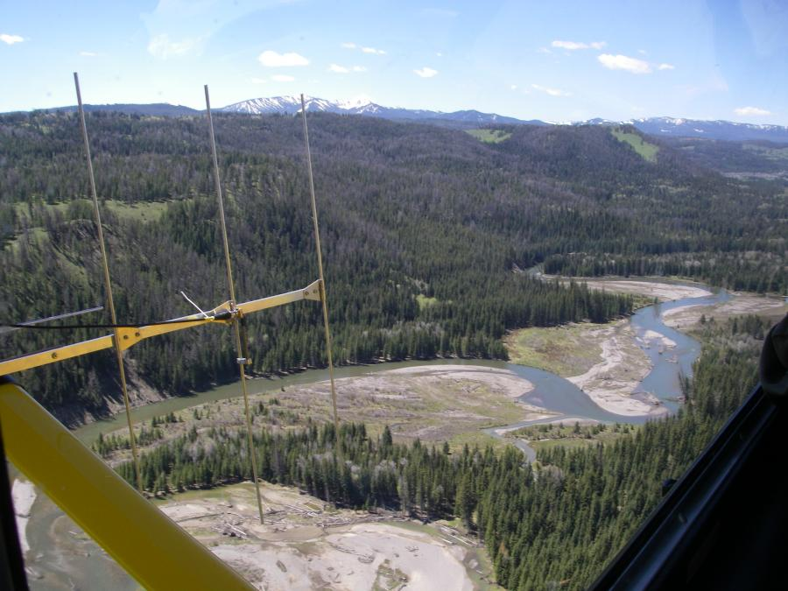
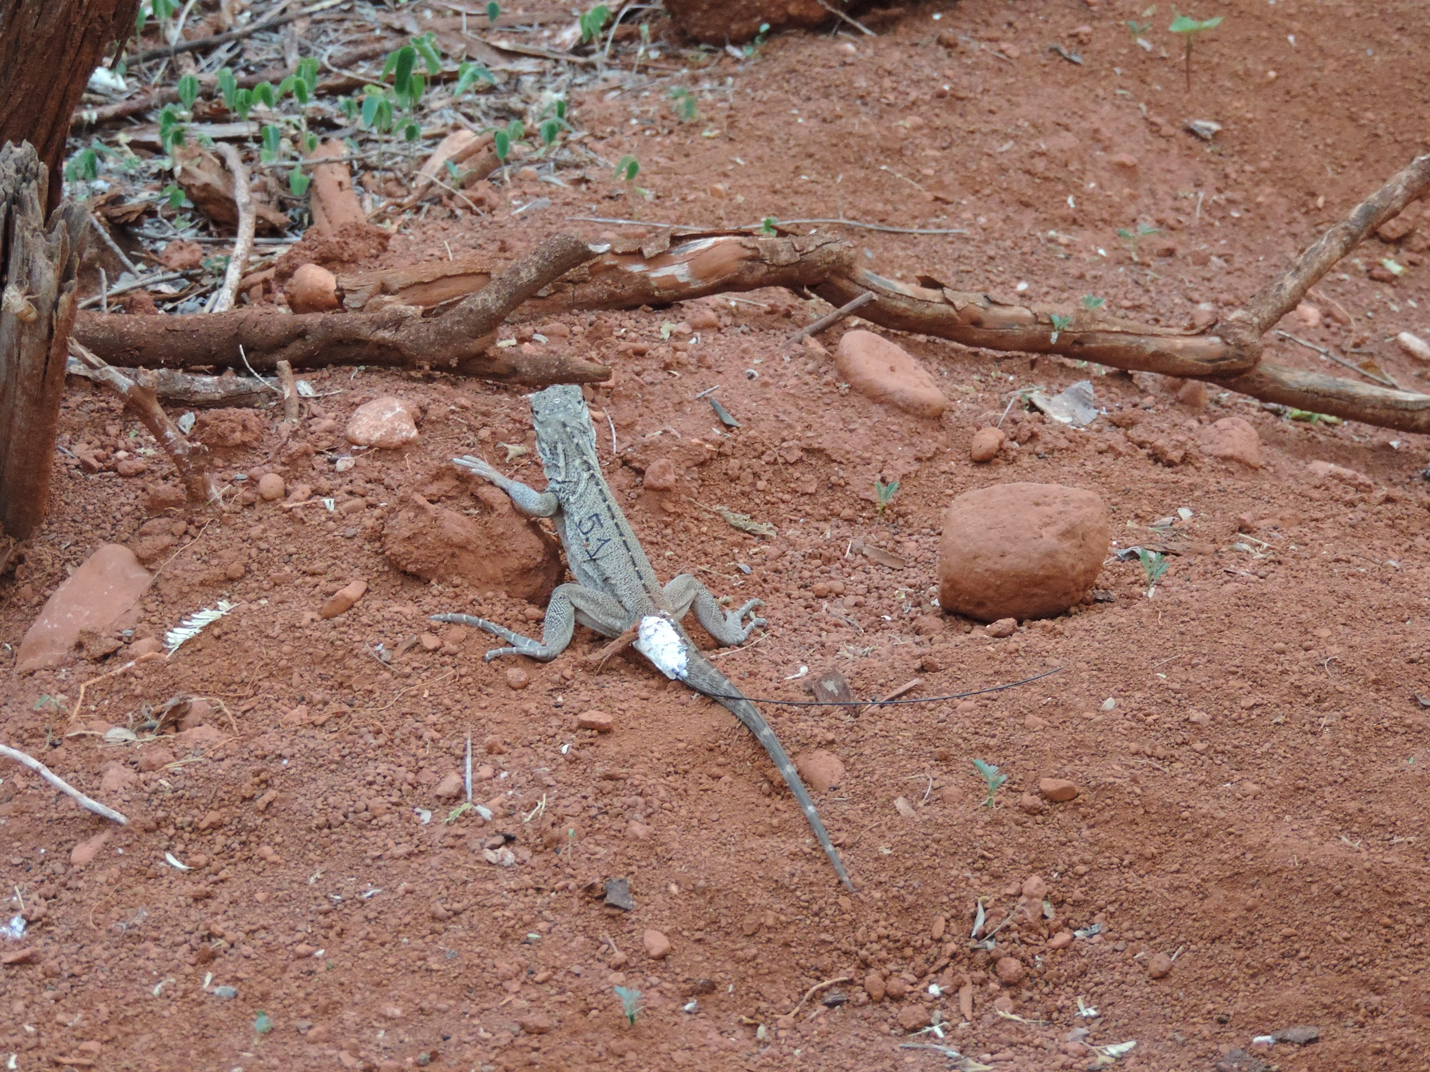
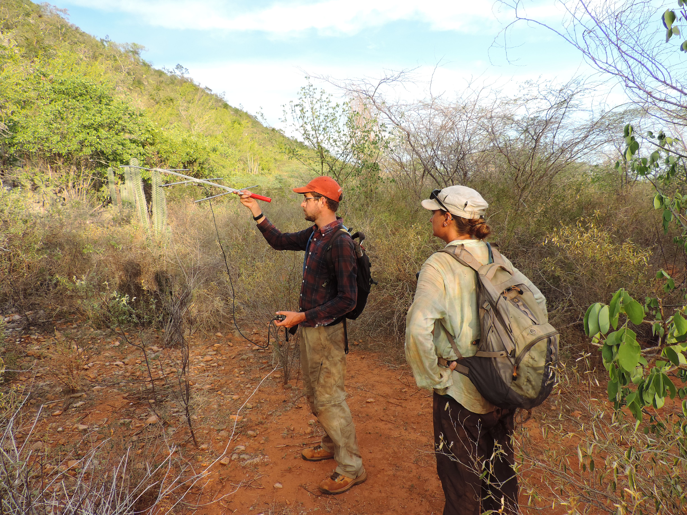
Project Motivation
Tracking wildlife radio collars an effective way of monitoring animal movement patterns
Environment can be difficult to traverse making tracking time consuming
Airborne Radio Telemetry
Iguana with Radio Collar
Terrestrial Radio Telemetry
Notes:
Sam: most of the class already knows about this, we can keep this brief

Slide 3
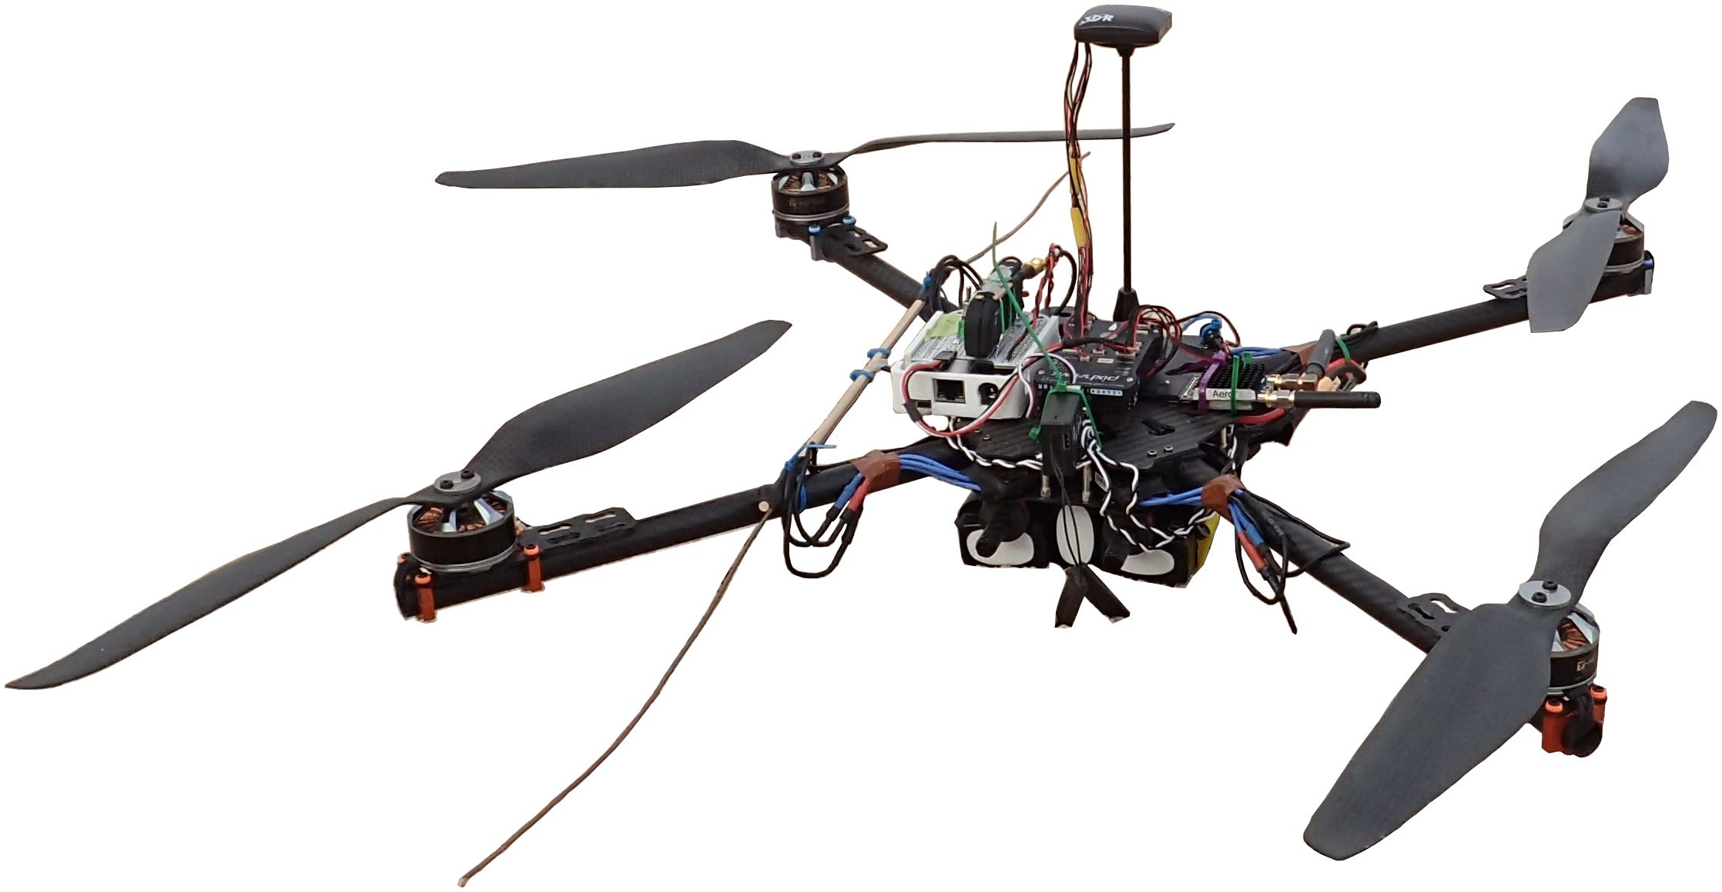
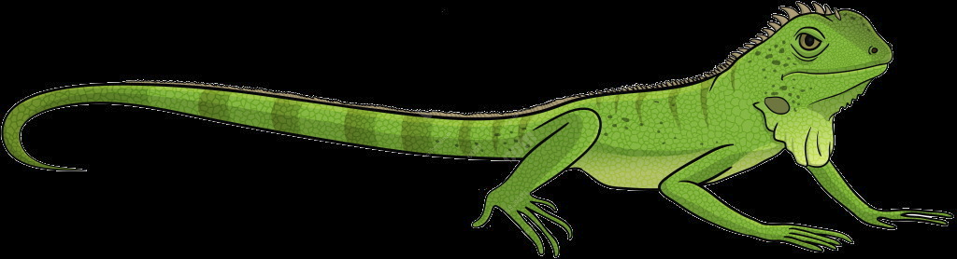
Solution
Radio collar tracking via an autonomous drone!
Drone flies over an area while recording signal strength using a software defined radio (SDR) and position using a GPS
Use DSP to extract the frequencies on which the radio collars are transmitting correlate with GPS to determine where they are located

Slide 4
Milestones
Milestone 1 (5/18):
GPS Parser working successfully parsing binary GPS data
UI Script to verify output directory sanity, disk space to write to, and SDR status
Radio Collar Emulator successfully matching radio collar’s current waveform

Slide 5
Milestones
Milestone 2 (6/11):
Integration and testing of GPS script and Intel Joule
The Web UI starting scripts enabled with status check
Emulator can produce at least one other waveform and measure detection

Slide 6
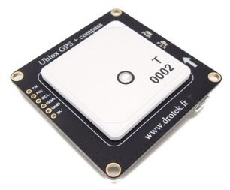
GPS Overview
Ublox M8N GPS & Compass
Previous attempts to access internal GPS data of 3DR Solo bricked multiple drones
New external Ublox GPS module requires binary UBX parsing scripts for 3D fix checking and general GPS data logging
GPS Python Scripts
GPS Python Scripts
Autopilot
GPS
Intel Joule
SDR
Raw Radio
FFT
Target Frequency
Correlator
Signal Amplitude per Location
Visualization

Slide 7

GPS Parsing Scripts
Python GPS scripts utilize pyUblox open source library to convert binary serial stream into parsable strings
gpsFix.py - only return from main() when 3D fix is found in NAV-STATUS message
ubx_gps_logger.py - log timestamped position and velocity from NAV-POSLLH message for radio collar ping correlation
...GPS 3D FIX: TRUE/FALSE...
...00111000101...
Outputs
serial
..LAT, LONG, ALT...
Ublox M8N GPS
UBX-NAV-SOL binary messages
Python GPS scripts

Slide 8
UI Script
Script performs functions:
Status
Start
Stop
Reload/Restart/Reset
Stop
Writable and Sane Output Directory
Status Check
Start GPS_Logger and SDR Recording
GPS Parse Script
GPS Lock/ 3D Fix
Restart
Enough available Disk Space
Verify working SDR

Slide 9
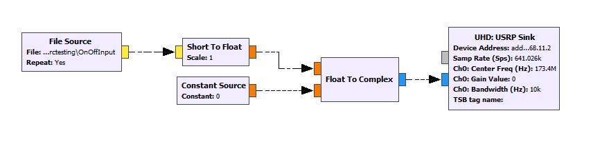
Radio Collar Emulator
Purpose is to increase detection range
USRP transmits for a short duration every 1.5 seconds
Waveform is a simple sine wave at the carrier frequency
Match the USRP signal with the radio collar’s signal

Slide 10
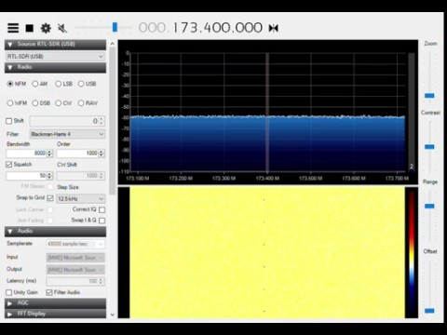
Radio Collar Emulator

Slide 11
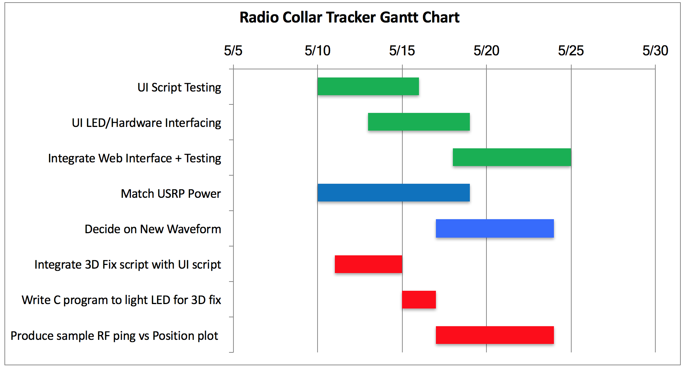
Sprint

Slide 12
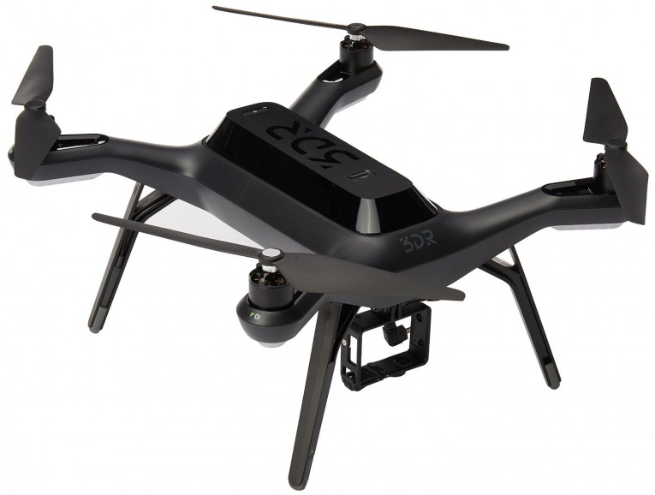
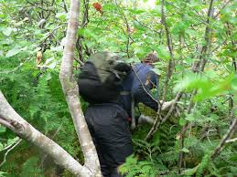

Don’t Bushwhack, Get a Drone
Bushwacking is no fun ;(
Drones are fun and avoid rough terrain!

